Slide 1
Inha University in Tashkent
Theme 7: Ontology: Philosophical Interpretation of Being

Slide 2
Outline:
Etymology of the term
The notion of being in philosophy
Views of Scholars on the concept of being
The areas of existence

Slide 3
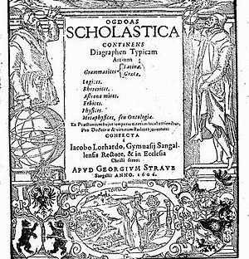
Etymology of the term
Ontology is the doctrine of existence and being.
As the philosophical branch it examines the fundamental principles of being, its most common entities and categories, structure and patterns.
It also studies the doctrine of existence in unity with the theory of knowledge and logic.
The term was firstly used by German philosopher Jacob Lorhard in his work “Ogdoas Scholastica” in 1606

Slide 4
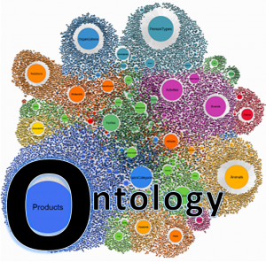
The notion of being in philosophy
Being is one of the most important categories of philosophy.
It expresses the problem of existence in its general form. The word "being" comes from the verb "to be." But as a philosophical category, "being" appeared only when philosophical thought posed the problem of existence and began to analyze this problem.
Philosophy has as its subject the world as a whole, the correlation of the material and the ideal, the place of man in society and in the world. In other words, philosophy seeks to clarify the question of the existence of the world and the existence of man.

Slide 5
The definition of the concept
In modern philosophical literature two meanings of the word "being" are predominated.
In the narrow sense of the word, this is an objective world that exists independently of consciousness; in the wide - this is all that exists: not only matter, but also the consciousness, ideas, feelings and even fantasies of people.
Being as objective reality is denoted by the term "matter".
Being has its opposite concept – non-being. And if being is all that exists, non-being is all that does not. And how does being and non-being relate to one another? This is a completely philosophical question, and we will see how it was determined in the history of philosophy.

Slide 6
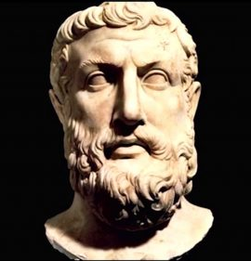
Parmenides (about 540 BC or 515 BC - about 470 BC) is an ancient Greek philosopher of Pre-Socratic period, founder and chief representative of the Eleatic school (the town of Elea; the possibility of motion). His views expressed in his metaphysical poem "On Nature".
He examined the concept of being. His main theses on being are as follows:
1) Besides being there is nothing. As well as the process of thinking is being;
2) Being is not generated by anyone; otherwise, one would have to admit that it originated from non-being, but there is no non-being;
3) Being is not subject to damage or destruction; otherwise, it would turn into non-being, but non-being does not exist;
4) Being has neither past nor future. Being is a present. It is motionless, homogeneous, perfect and limited.
Main slogan of Parmenides is: "There is a Being and there is no non-existence".

Slide 7
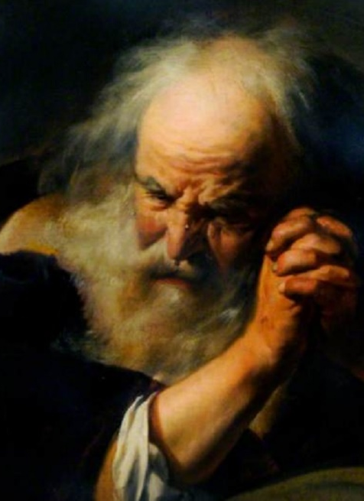
Heraclitus
In contrast to Parmenides, Heraclitus (535-475) focuses on the motion.
The universe for him is a cosmos, not created by any of gods and by none of the people, but was, is and will be forever as a living fire.
But Heraclitus suggests that the universe is in perpetual motion. The thought of Heraclitus differs from the concept of immovable being by Parmenides.
However, Heraclitus is not limited to the statement about the mobility of the universe. He regards the movement itself as a result of the mutual transition of opposites. Being and non-existence are inseparable. One generates another, one passes into the other.

Slide 8

The Theory of Greek scholars
Developing a materialistic philosophy, the later ancient philosophers-materialists Leucippus and his disciple Democritus (around 460 - about 370 BC) tried to overcome contradictions in the doctrine of being and developed the concept of atomism. Atoms are indivisible particles of matter. All visible bodies are composed of atoms.
Atomistic teaching was accepted and developed by the materialists of Ancient Greece and Rome, primarily philosophers such as Epicurus (341-270 BC) and Titus Lucretius Car (about 99 - about 55 BC). Later atomism revives in the philosophy of modern times.
However, at the end of the 5th century BC ancient Greek philosophy received a great development of completely different philosophical systems - the systems of idealistic philosophy. And it is quite natural that in these systems a completely different doctrine of being is presented.

Slide 9
Patterns of the periods
The third century in the history of Europe was a transitional period.
The old, ancient world disintegrated, a new world was born, feudal Europe arose. And at the same time, a new religion - Christianity - has arisen and has become increasingly popular.
The former Greek and Roman gods were gods of polytheistic religions. They symbolized elements or parts of nature and were themselves recognized by parts, elements of this nature: the gods of heaven and earth, the sea and the underworld.
They lived somewhere near, very close, and often entered into direct relations with people, determining their fate, helping one in war against others. They were a necessary addition to nature and social life.
The dominant monotheistic religious worldview had completely different gods, more precisely, a completely different god. He alone was the creator of heaven and earth, the creator of plants, animals and man. It was a revolution in the worldview. In addition, the legalization of Christianity and its recognition as a state religion of the Roman Empire gave birth to the process of exclusion all other views from the life of society.

Slide 10
Ontology in Medieval Period
Scholastic approach towards ontology
Reconsideration of Aristotelianism
Legacy of Ibn Sina and Ibn Rushd
“The world has beginning, but God could have created in a such a way that it existed eternally” – Thomas Aquinas
Heliocentrism

Slide 11
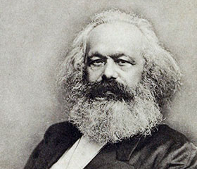
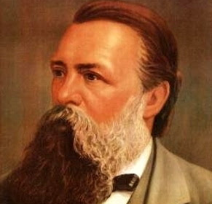
19th-early 20th Centuries
The end of the nineteenth and early twentieth centuries was characterized by the fact that in philosophy great attention was paid to the problems of cognition.
Gnoseology took the dominant position. Moreover, there are developing doctrines that deny the importance of general philosophical concepts and call for the rejection of such fundamental philosophical concepts as matter, spirit, and being.
The long dominance of religious ideology, the relative weakness and limited scope of the influence of materialistic teachings, the existence of society was considered idealistically.
A fundamentally different situation arose in the 1840s and 1850s. XIX century, when the foundations of dialectical materialism were developed and the basic principles of the materialist understanding of history were formulated.
This was done by Karl Marx and Friedrich Engels. In philosophy, a new concept was introduced: "social or public being." Public being is the intrinsic, internal foundation of the existence and development of society, not identical with its natural basis.
Big Bang theory was introduced in 1920s about the metaphysics that dominates till present.

Slide 12
The areas of existence
Traditional philosophical views distinguish three areas of existence. They include nature, society, consciousness (the state of awareness). The most common feature for them is their existence. Also, in the philosophical literature there are different forms of natural being and social existence: Natural being is often understood as bodies of the nature and processes. It is divided into two parts: the existence of the eternal nature (or the natural entity, which existed before and without human participation), and the being that produced by human labor (the "second nature", that is, culture).
The second nature consists in the following expressions:
- human existence;
- spiritual existence;
- the existence of a social being

Slide 13
Thank you for your attention!

